Slide 1
Image Processing in Python
Matthew Lowe
Matthew.Lowe2@christie.nhs.uk

Slide 2
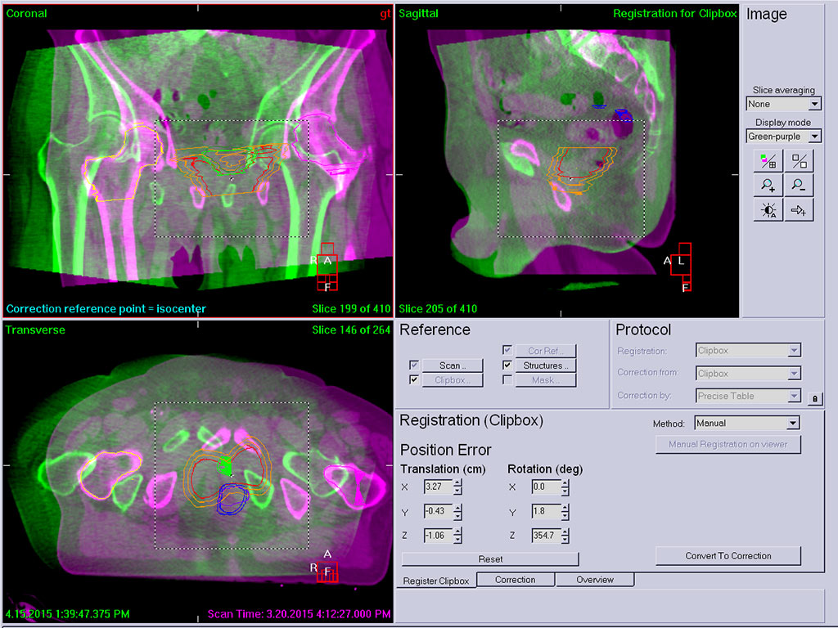
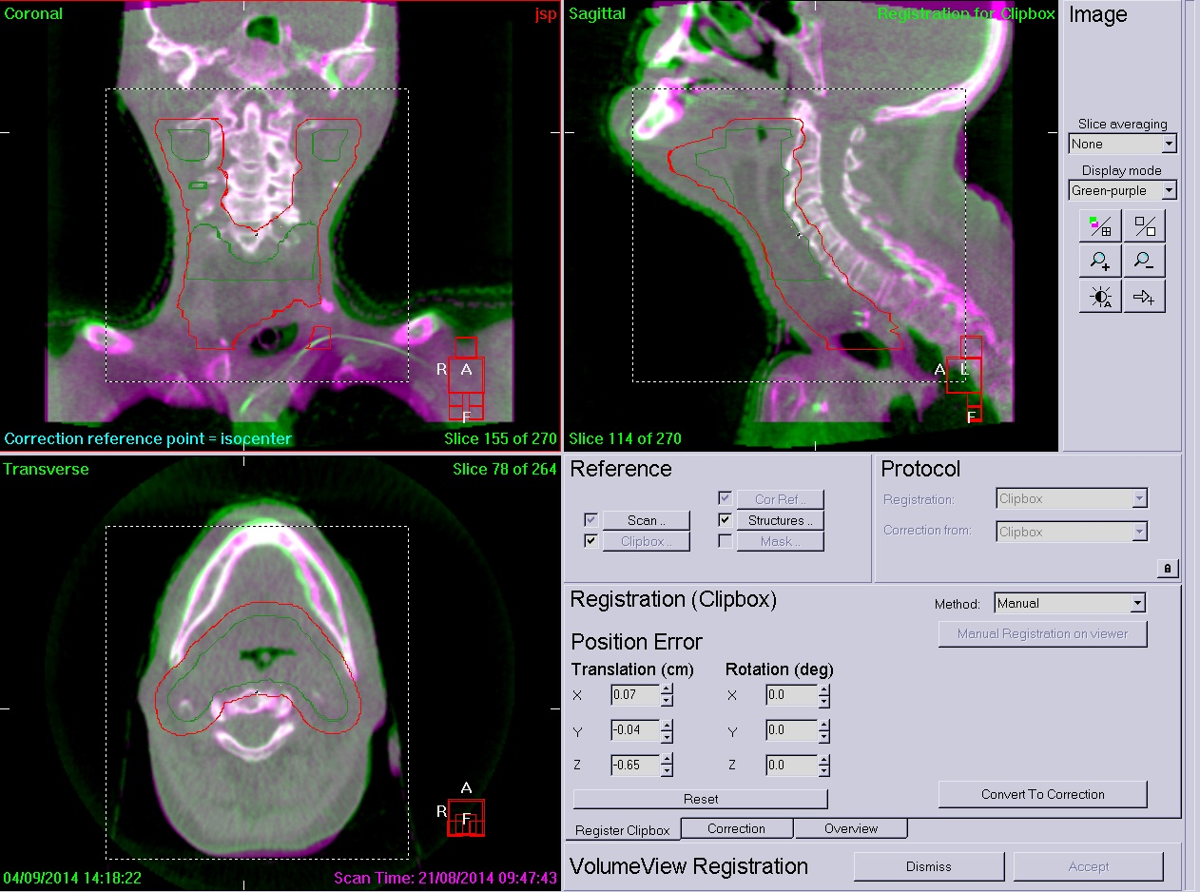

Slide 3


Slide 4
In this session we will learn about:
Loading images
Using colourmaps
Zooming/cropping
Shifting images
Applying masks
Flipping images
Rotating images
Blurring images
Overlaying images
Using transparency
Resizing images
Setting different window levels
You will be able to try these out during this session using the workbook.
Feel free to experiment to help you understand what is being done.

Slide 5

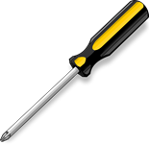
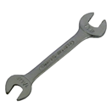
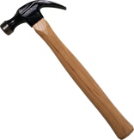
First let’s import some useful libraries
import matplotlib.pyplot as plt import numpy as np
from scipy import misc
plot()
read()
libraryA
mean()
read()
libraryB

Slide 6
Function: imread belongs to the ‘misc’ namespace
image = misc.imread("bird.jpg")
Variable name:
Could be anything. Try to pick something meaningful. Ideally, function names should be lowercase, with words separated by underscores as necessary to improve readability.
Function arguments:
In this case it is the file that we want to open.
Because it is in the same folder we can just write the name of the file. Otherwise we would write the path to the image.

Slide 7
Function: imshow belongs to the ‘plt’ namespace. It displays an image on some axes
plt.imshow(image)
Function arguments:
In this case it is the variable holding the image data.
Lots of other arguments are available. We’ll see some later.
http://matplotlib.org/api/pyplot_api.html#matplotlib.pyplot.imshow
plt.show()
Displays the figure

Slide 8
print image
print image.shape
Array dimensions
An image is just an array of numbers.
What is the shape of the array?
Why does it have this shape?

Slide 9
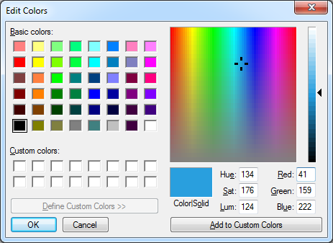

Slide 10
We want to copy the array that is stored in the variable “image”
New variable
blue_image = image.copy()
blue_image[:, :, 0] = 0
blue_image[row, column, channel] = 0
This sets the first channel in every pixel to be zero
Remember:
[1:5] is equivalent to “from 1 to 5” (5 not included)
[1:] is equivalent to “1 to the end”
[:5] is equivalent to “from the start to 5” (5 not included)
So, [:] means from the start to the end

Slide 11
Creates a new figure as a variable called “fig”
fig = plt.figure() ax = fig.add_subplot(221) ax2 = fig.add_subplot(222) ax3 = fig.add_subplot(223) ax4 = fig.add_subplot(224) ax.imshow(image) ax2.imshow(red_image) ax3.imshow(blue_image) ax4.imshow(green_image)
plt.show()
Add some axes
Here, there are 2x2 subplots
1
2
3
4

Slide 12
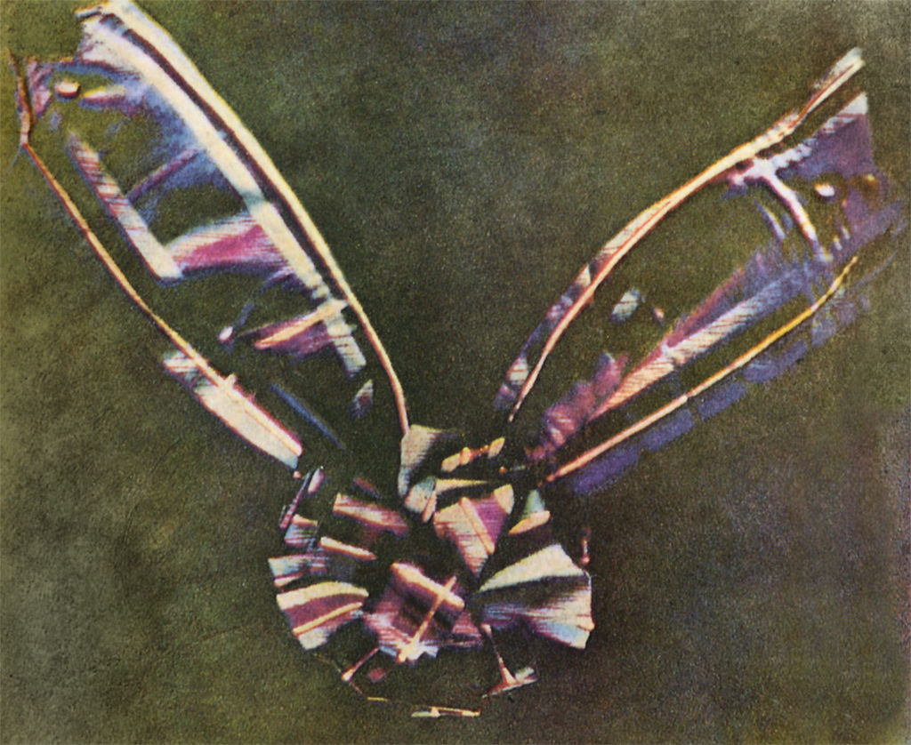

Slide 13
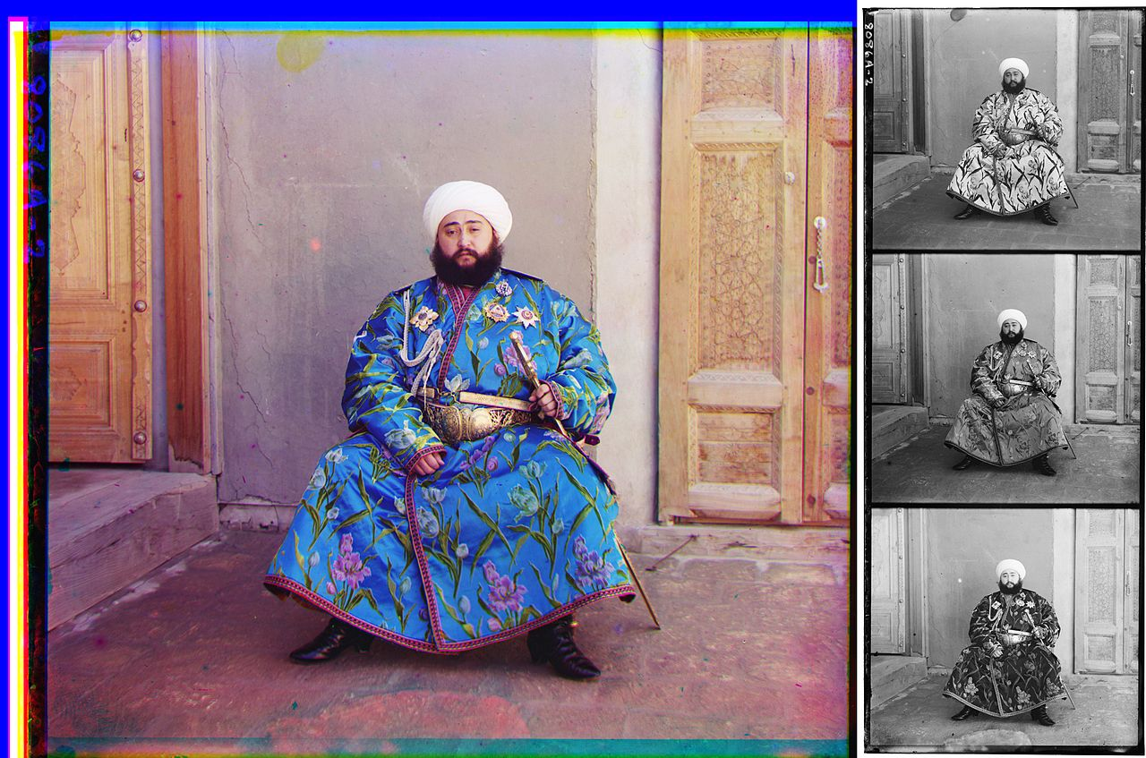
A photograph of Mohammed Alim Khan (1880–1944), Emir of Bukhara, taken in 1911 by Sergei Mikhailovich Prokudin-Gorskii using three exposures with blue, green, and red filters.

Slide 14
We have 3 colour channels (In some cases we might have 4 channels, in this case the last one is transparency)
Let’s simplify things and just have one value for each pixel. This value should contain the mean value over the three channels.
We will use the “mean” function from numpy (Remember we imported it as “np” earlier)
With numpy we can do functions on arrays very efficiently without having to loop through every element
mean_image = np.mean(image, -1)
Function arguments: The first argument here is the array we want to calculate the mean over. The second argument is an axis we are calculating this over. -1 means the last one, we could put a 2 here instead.

Slide 15
a = np.linspace(0,24,25) a.shape=(5,5)
np.mean(a) np.mean(a,0) np.mean(a,1) np.mean(a,-1)
What is the output of:

Slide 16
We’ve now averaged over all three colour channels*.
What happens if we display this array now?
Why does it look like this?
*There’s an easier way to flatten the image though:
image = misc.imread("bird.jpg“, flatten=True)

Slide 17
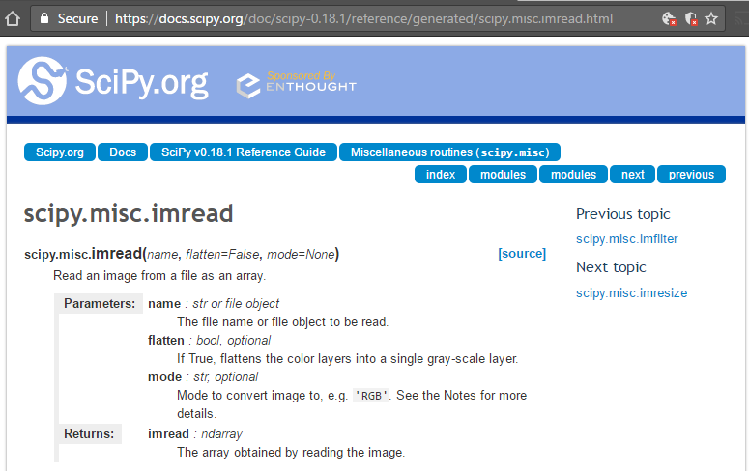
We don’t have to use the keyword if we specify the arguments in order.
It might make things easier to read though.
If we don’t specify these optional arguments they will take default values.

Slide 18
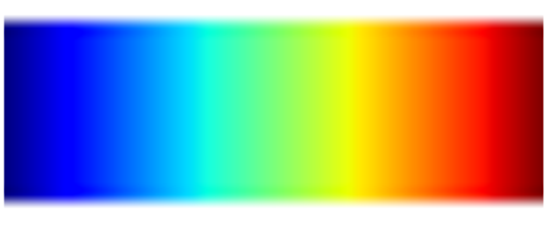
The image is now using the default colourmap.
A colour map translates numbers into different colours. The default colour map (called “jet”) looks like this:
Is this a good colourmap?
Low value
High value

Slide 19
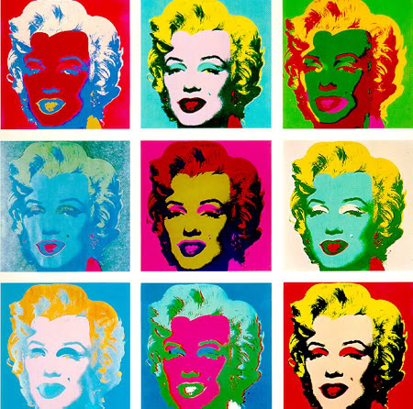
Let’s explore some other colourmaps

Slide 20
Try some of these colour maps:
viridis, inferno, plasma, magma, Blues, BuGn, BuPu, GnBu, Greens, Greys, Oranges, OrRd, PuBu, PuBuGn, PuRd, Purples, RdPu, Reds, YlGn, YlGnBu, YlOrBr, YlOrRd, afmhot, autumn, bone, cool, copper, gist_heat, gray, hot, pink, spring, summer, winter, BrBG, bwr, coolwarm, PiYG, PRGn, PuOr, RdBu, RdGy, RdYlBu, RdYlGn, Spectral, seismic, Accent, Dark2, Paired, Pastel1, Pastel2, Set1, Set2, Set3, gist_earth, terrain, ocean, gist_stern, brg, CMRmap, cubehelix, gnuplot, gnuplot2, gist_ncar, nipy_spectral, jet, rainbow, gist_rainbow, hsv, flag, prism
What happens if you put “_r” after the name
(e.g. “Greys_r”)?

Slide 21
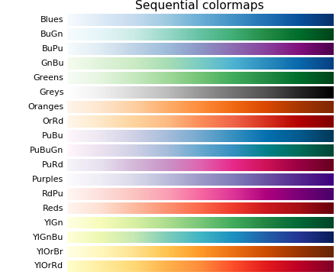
Sequential: These colourmaps are approximately monochromatic colourmaps varying smoothly between two colour tones-usually from low saturation (e.g. white) to high saturation (e.g. a bright blue). Sequential colourmaps are ideal for representing most scientific data since they show a clear progression from low-to-high values.
http://matplotlib.org/users/colormaps.html

Slide 22
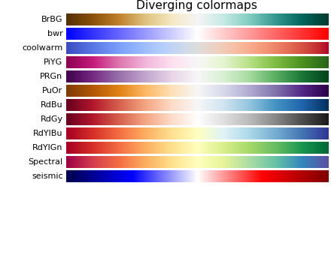
Diverging: These colourmaps have a median value (usually light in colour) and vary smoothly to two different colour tones at high and low values. Diverging colourmaps are ideal when your data has a median value that is significant (e.g. 0, such that positive and negative values are represented by different colours of the colourmap).
http://matplotlib.org/users/colormaps.html

Slide 23
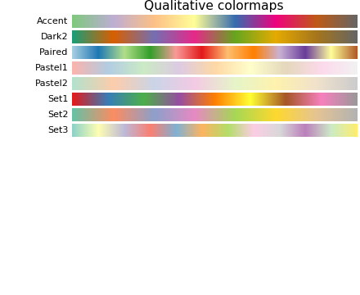
Qualitative: often are miscellaneous colours; should be used to represent information which does not have ordering or relationships.
http://matplotlib.org/users/colormaps.html

Slide 24
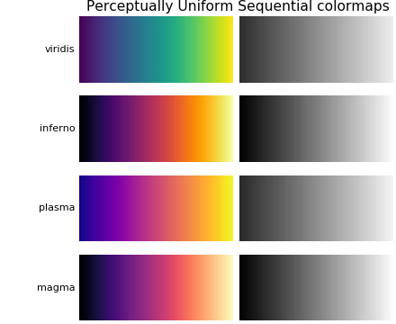
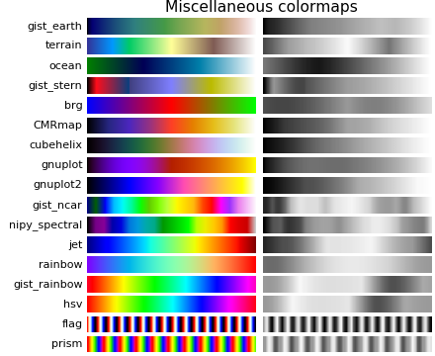
What is intuitive?
What is standard?
How would it look in black and white?
How would it be perceived by readers with colour-blindness? (4.5% of people) http://www.color-blindness.com/coblis-color-blindness-simulator/

Slide 25
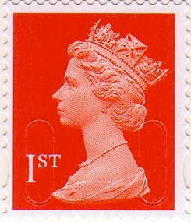
Let’s make a stamp

Slide 26
im = misc.imread("thequeen.jpg")

Slide 27
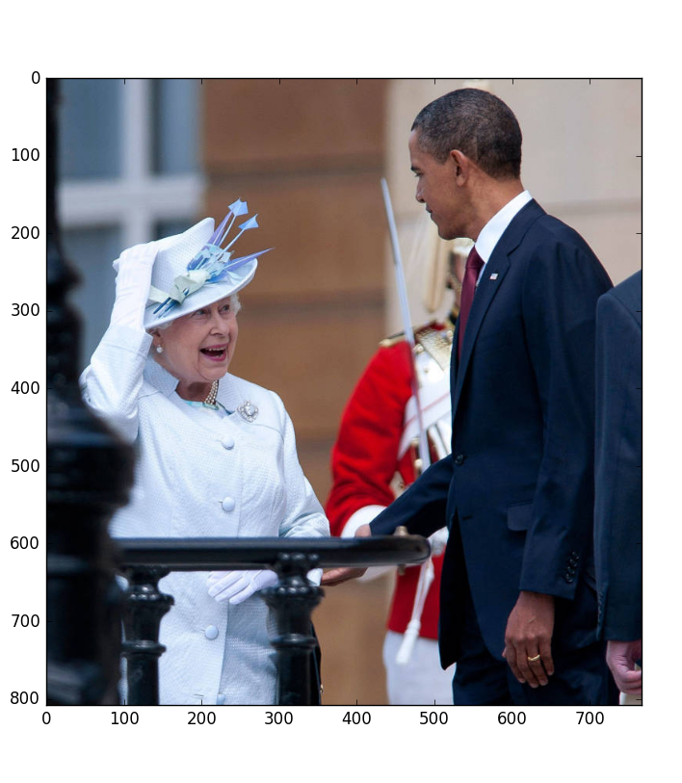

Slide 28
We can slice an array just like we can slice a list, each dimension is separated by a comma
cropped = im[row_{start}:row_{stop}, col_{start}:col_{stop}]

Slide 29
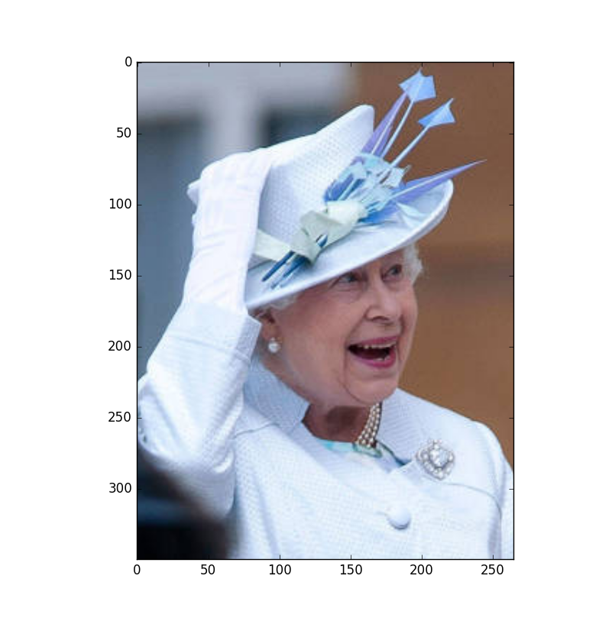

Slide 30
flipped = np.fliplr(cropped)
or
flipped = cropped[:,::-1]

Slide 31
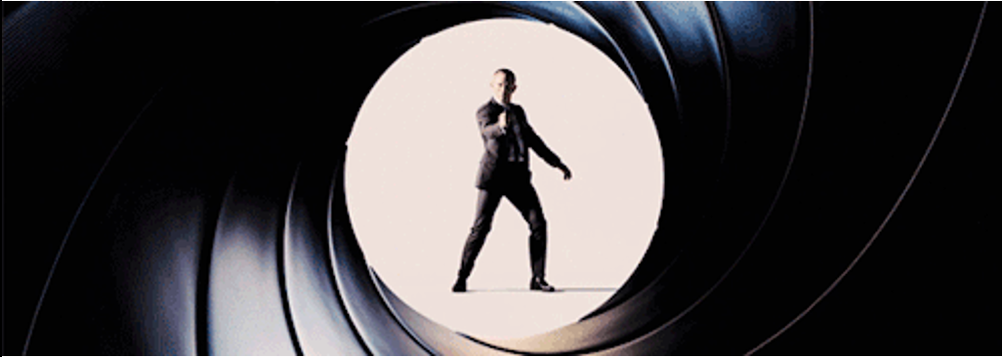
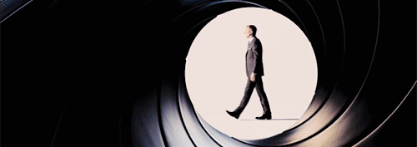

Slide 32
A new variable
The shift along the axes as a tuple
shifted_image =
interpolation.shift(im, (60, -20), mode="nearest")
The array we want to shift
How points outside the array should be filled. Nearest means that they take the value of the nearest point

Slide 33
Remember, this gave us the array dimensions as a tuple.
We are now assigning these dimensions to the variables lx and ly
lx, ly = shifted_image.shape
This gives us a grid with one horizontal array and one vertical array
X, Y = np.ogrid[0:lx, 0:ly]
mask = (X - lx / 2) ** 2 + (Y - ly / 2) ** 2 > lx * ly / 3
The mask is an inequality… It is also an array so it will be made out of Trues and Falses

Slide 34
With this reference, we are only picking out the array elements that are True
shifted_image[mask] = 0

Slide 35
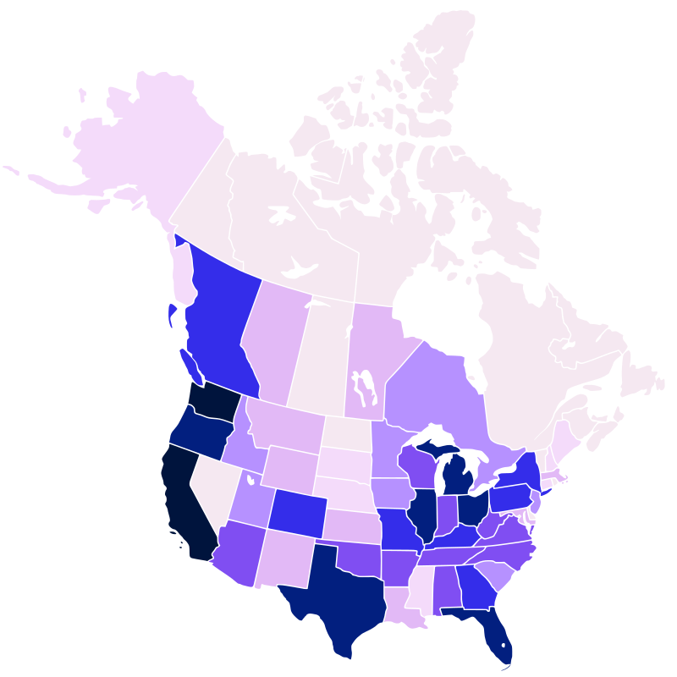

Slide 36
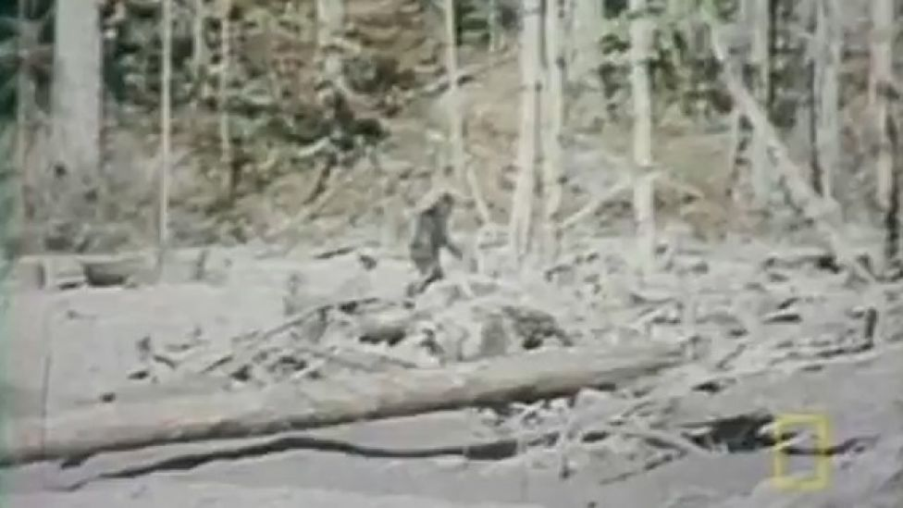

Slide 37
The standard deviation of the gaussian
blur = ndimage.gaussian_filter(im, sigma=20)
The image we want to blur
We could achieve something similar by convolving with a Gaussian similar to how you used convolution yesterday.

Slide 38
The rotation angle
rotated = ndimage.rotate(im, angle=20)
The image we want to rotate

Slide 39
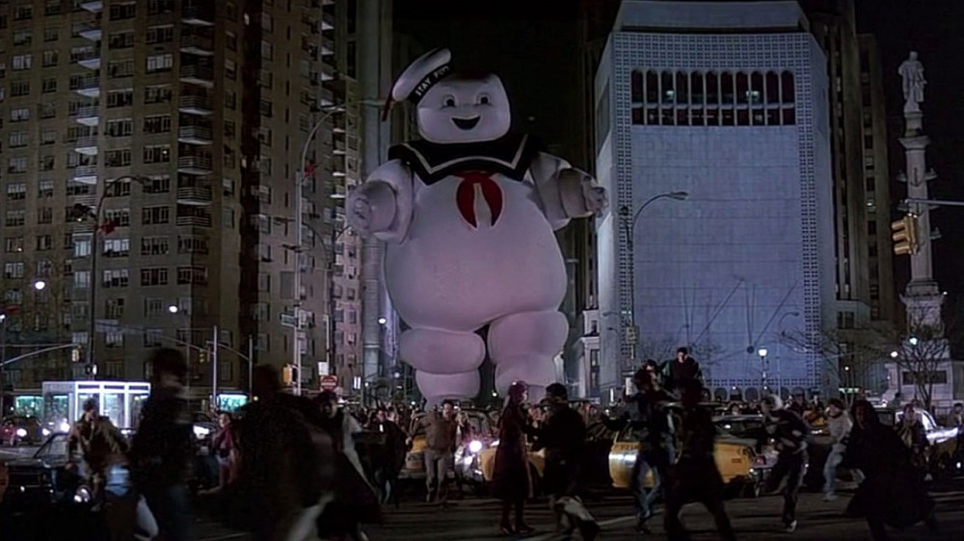
How to handle a large ghost

Slide 40
We can display multliple plots at the same time. Anything we plot before calling plt.show() will appear on the same figure. However, underlying images may be obscured by subsequent images.
We can use the keyword “alpha” to set the transparency of an image.
Try changing the alpha value between 0 and 1.
plt.imshow(im_room, cmap="Greys_r")
plt.imshow(im_ghost, alpha=0.5, cmap="Greys_r")
plt.show()

Slide 41
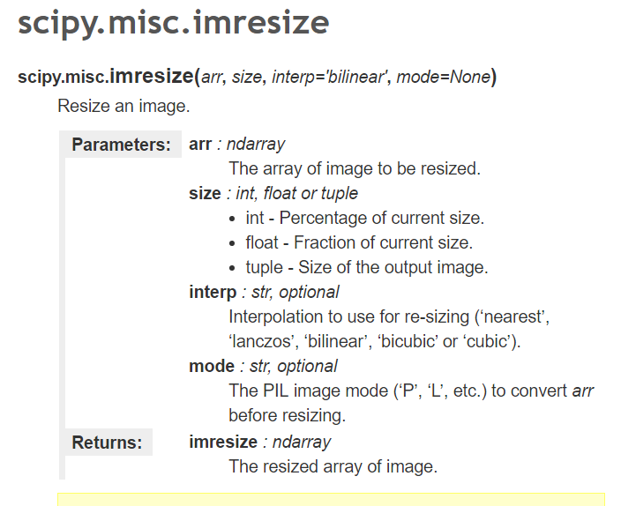

Slide 42
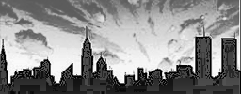
Image:
http://www.ironicsans.com/
http://www.joshmillard.com/

Slide 43
The data we will plot a histogram of.
im.flatten() returns a copy of the array “im” with only 1 dimension.
The colour of the bars
ax2.hist(im.flatten(),bins=10,facecolor="Red",edgecolor="Black")
The number of histogram bins
The colour of lines around the bars

Slide 44
Sets the minimum value in the window
plt.imshow(im, cmap="Greys_r", vmin=100, vmax=255)
Sets the maximum value in the window

Slide 45

2000
1900
1800
1700
1600
1500
1400
1300
1200
1100
1000
900
800
700
600
500
400
300
200
100
0
vmin = 400
vmax = 1700
vmin = 500
vmax = 1200
vmin = 1100
vmax = 1800

Slide 46
2000
1900
1800
1700
1600
1500
1400
1300
1200
1100
1000
900
800
700
600
500
400
300
200
100
0
vmin = 400
vmax = 1700
vmin = 500
vmax = 1200
vmin = 1100
vmax = 1800

Slide 47
2000
1900
1800
1700
1600
1500
1400
1300
1200
1100
1000
900
800
700
600
500
400
300
200
100
0
Level
Window
Level
Window
Level
Window
Level
Window
vmin = 400
vmax = 1700
vmin = 500
vmax = 1200
vmin = 1100
vmax = 1800

Slide 48
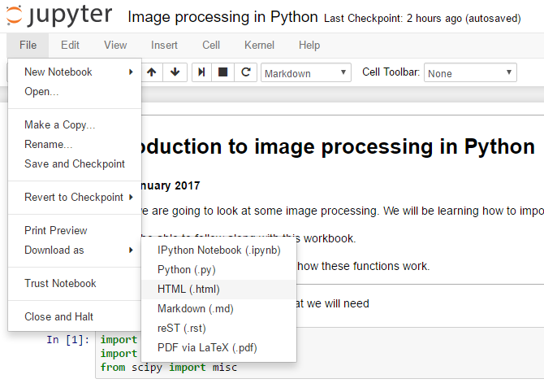
You can save your workbook to a pdf or html so that you have a copy of what you’ve done.

Slide 49
Image processing in Python:
Practical session

Slide 50
We wouldn’t normally write code in a notebook like we did this morning.
This afternoon, we are going to write code in a file which we can run.
You can write code in an interactive development environment (IDE) or even just a text file.
You can run your code from the command line:
python example.py
The code we want to run. If we are not in the same directory as the code we would have to change to that directory or write out the whole file path.

Slide 51
Part 1.
Read and display a CT image.
Plot a histogram of the CT image.
Write a function that displays the CT image with different window levels. The input variables should be the window and level.
Identify which parts of the image the histogram relates to.

Slide 52
Part 2.
Load in the 2 CT images and display them on the same plot
Use transparency to create a “fusion window” showing both of the images on the same axes.
Find the changes required to align the 2 images.
Map shifts and rotations to keyboard presses to interactively align the images

Slide 53
Extras.
Quantify how good your alignment is.

Slide 54
Remember…
Comment your code.
Use appropriate names.
The python documentation contains a lot of useful information.
You will find some useful hints in the instructions.

Slide 55
You can connect a matplotlib figure to a key_press_event like this:
This connects the figure "fig" to key presses. When a key is pressed the specified function (here it is called "eventHandler") is called. The first argument of this function is the event.
fig.canvas.mpl_connect('key_press_event', eventHandler)

Slide 56
In the event handling function you can find out which key was pressed by using the command whichKey.
Try printing out whichKey to see what different keys are called. Try doing combinations like ALT+UP.
def eventHandler(event): up = 0 whichKey = event.key if whichKey == "up": up = 1 print up

